Slide 1
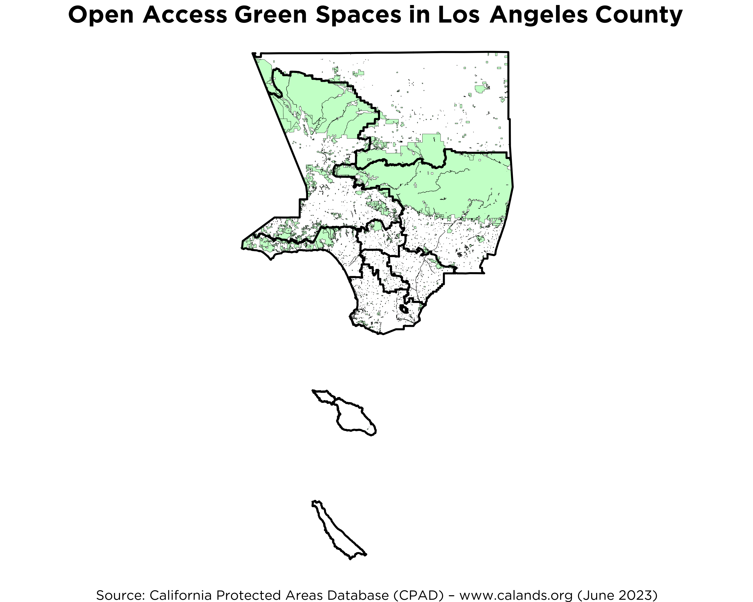
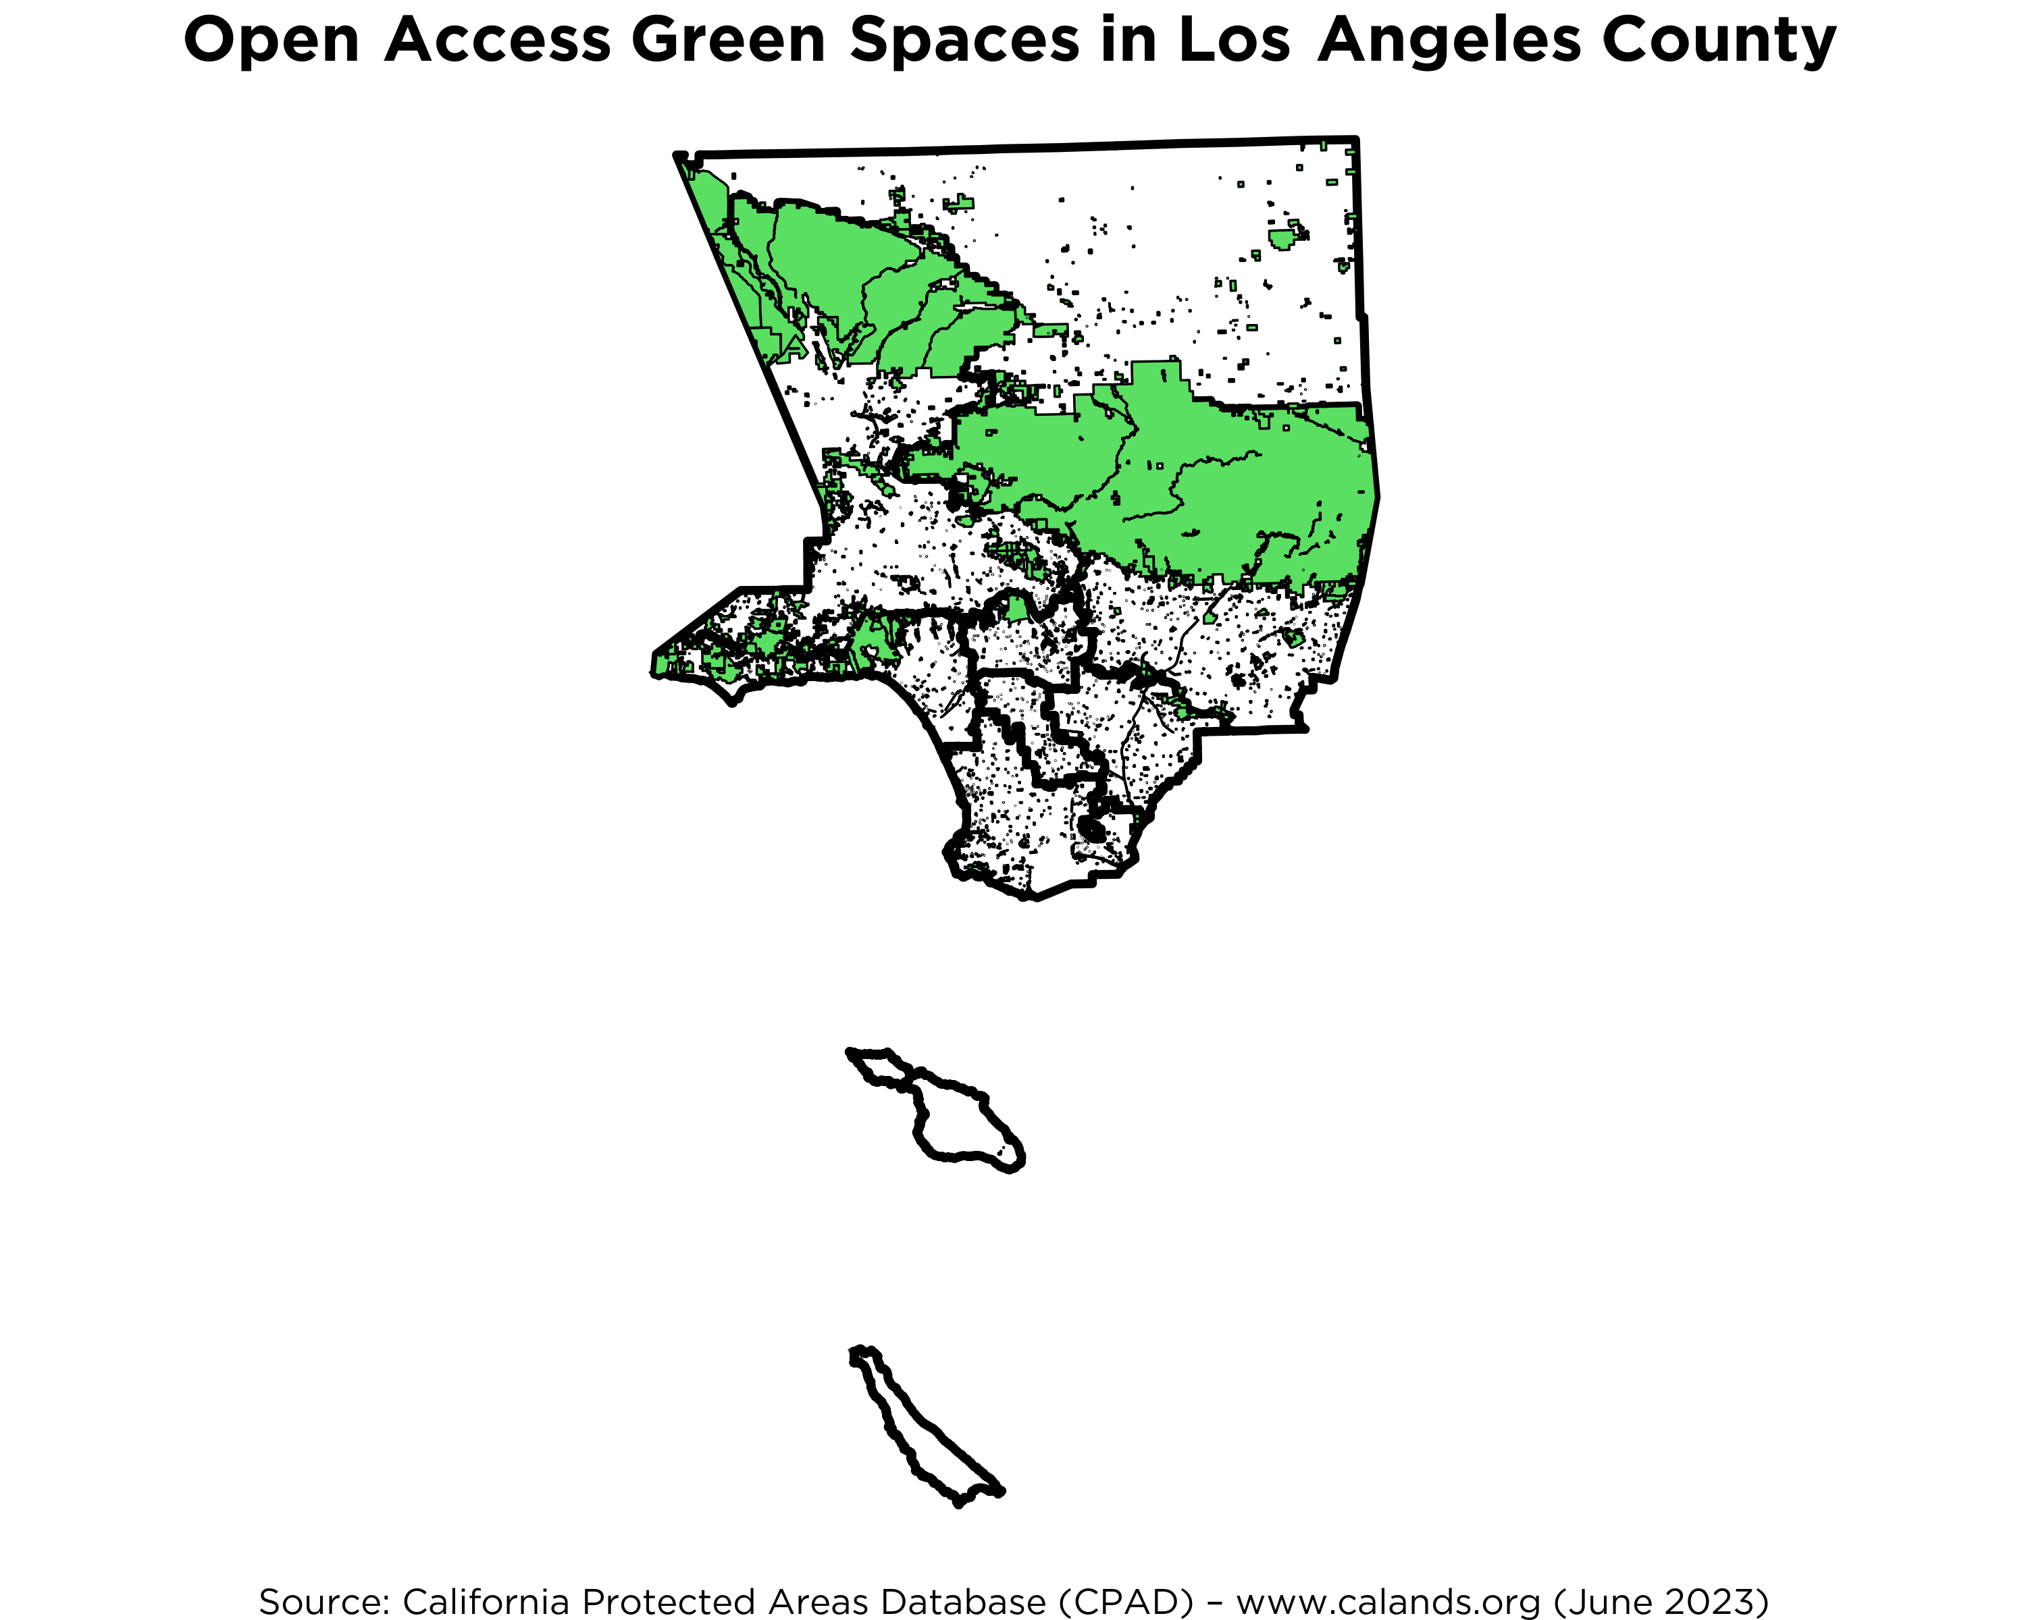
Parks & Open Space
1
2
Map includes open access/open for public use city and neighborhood parks, regional and county parks, preserves, watersheds and acquired flood management areas, state and national parks, national forests and Bureau of Land Management lands, as well as protected public farmlands and ranchlands. Map excludes civic centers, dumps, military lands, and sovereign tribal lands unless reported as public by the tribe.
3
4
5
6
7
Not to scale
8
SPAs outlined & numbered
Source: California Protected Areas Database (CPAD) –www.calands.org (June 2023)

